Slide 1
Introduction to Cloud Computing
Sharath Sahadevan

Slide 2
Agenda
What is Cloud Computing?
Amazon
Google App Engine for Java
Demo sample apps

Slide 3
What is Cloud Computing?

Slide 4
What is Cloud Computing?
“A style of computing where scalable and elastic IT-enabled capabilites are provided as a service to external customers using Internet technologies” – Gartner

Slide 5
Cloud Computing
Pay as you go
Uses shared data centers
Platform as a service
Software as a service
Minimize expenses
Improve business agility

Slide 6
Evolution of Computing
Mainframes
Minicomputers
PC’s
Smart, portable devices

Slide 7
Cloud Computing in the news
“The rise of the cloud is more than just another platform shift that gets geeks excited. It will undoubtedly transform the IT industry, but it will also profoundly change the way people work and companies operate.”
—The Economist, “Let it Rise,” 10/23/08
I.B.M. to Help Clients Fight Cost and Complexity – NY Times, June 14, 2009

Slide 8
Cloud Computing in the news
VMware buys SpringSource in cloud move – InfoWorld, Aug 10,2009
“The two companies plan to build solutions for more efficiently running, building, and managing applications within internal and external cloud architectures.”

Slide 9
Cloud Computing in the news
Google and the wisdom of Clouds – Business Week, December 2007
Micorsoft to launch cloud computing service – ComputerWeekly, March 2008
The Internet Industry is on a Cloud – Whatever that may mean- Wall Street Journal , March 26, 2009

Slide 10
Projections for Cloud Computing
Estimates vary widely
Research Firm IDC - $42 B in 2012
Gartner Inc – World Wide Cloud services revenue will rise 21% to $56.3 B in 2009

Slide 11
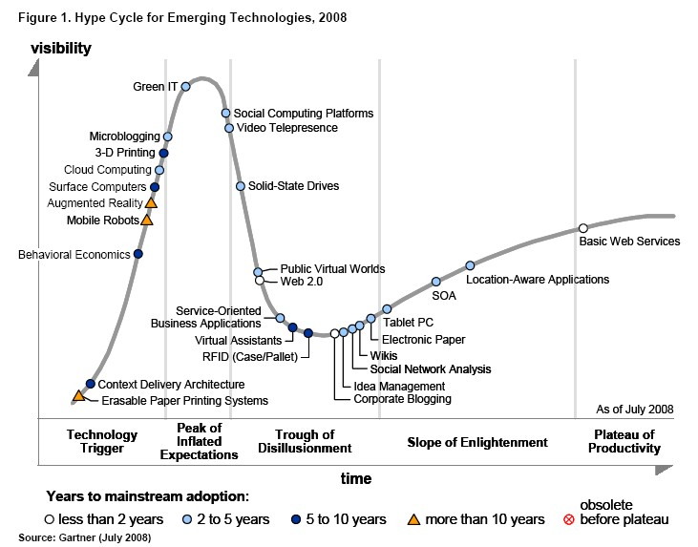

Slide 12
Leaders
Amazon – Elastic Compute Cloud service
Google – App Engine
Salesforce
Microsoft – Azure services
IBM

Slide 13
Risk Mitigation - Gartner
Privileged user access—Who has specialized access to data and about the hiring and management of such administrators?
Regulatory compliance—Is the vendor willing to undergo external audits and/or security certifications?
Data location—Does the provider allow for any control over the location of data?
Data segregation—Is encryption available at all stages, and were these encryption schemes designed and tested by experienced professionals?

Slide 14
Risk Mitigation
Recovery—What happens to data in the case of a disaster, and does the vendor offer complete restoration, and, if so, how long does that process take?
Investigative Support—Does the vendor have the ability to investigate any inappropriate or illegal activity?
Long-term viability—What happens to data if the company goes out of business, and is data returned and in what format?
Data availability—Can the vendor move your data onto a different environment should the existing environment become compromised or unavailable?

Slide 15
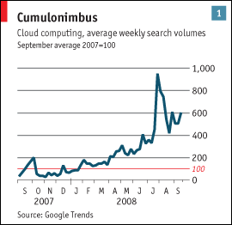
Cloud Computing – Search volumes

Slide 16
Amazon Services
Amazon Elastic Compute Cloud
Amazon Simple Storage Service – Optimized for large objects, dense storage drives, stores raw data
Amazon Simple DB – Optimized for data access speed, less dense storage drives.
Amazon Simple Queue Service

Slide 17
Amazon EC2
Web service
Provides resizable computing capacity
Cloudwatch – Monitoring web services
Available in two regions:
- US and Europe

Slide 18
Amazon EC2 – Supported OS
Red Hat Enterprise Linux
Windows Server 2003
Oracle Enterprise Linux
OpenSolaris

Slide 19
Amazon EC2 – Supported Databases
IBM DB2
Oracle 11g
Microsoft SQL server
MySQL Enterprise

Slide 20
Amazon SQS
Simple Queue Service
Exposes Amazon’s messaging infrastructure as a web service

Slide 21
Google App Engine - Supported
Java Data Objects (JDO)
Java Persistence API (JPA)
Java Server Faces (JSF) 1.1
Java Server Pages (JSP) + JSTL
Java Servlet API 2.4
JavaBeans™ Activation Framework (JAF)
JavaMail
XML processing APIs including DOM, SAX, and XSLT

Slide 22
Google App Engine – Not Supported
Enterprise Java Beans (EJB)
JAX-RPC
JAX-WS
JAXB
Java Database Connectivity (JDBC)
Java EE™ Connector Architecture (JCA)
Java Management Extensions (JMX)
Java Message Service (JMS)
Java Naming and Directory Interface (JNDI)
Remote Method Invocation (RMI)

Slide 23
Storing the data
App Engine's underlying datastore is based on BigTable, not a traditional SQL-based RDBMS like MySQL or PostgreSQL.
You may either use the low-level datastore API or the JDO or JPA object-relational mapping interfaces provided.
Various JDBC wrappers are available for the datastore, and you may still be able to connect to in-memory databases such as the H2 database engine or HSQLDB.

Slide 24
Google AppEngine restrictions
Cannot write to the filesystem. Can read files
Cannot Spawn a new thread.
Cannot open a socket to another host
The app must respond within 30 seconds, or you will see DeadlineExceededException.
System methods like exit(), gc() do nothing.

Slide 25
Additional Limits
request size=10 megabytes
response size=10 megabytes
request duration=30 second
maximum number of application files =1,000
maximum number of static files=1,000
maximum size of an application file=10 megabytes
maximum size of a static file=10 megabytes
maximum total size of all application and static files=150megabytes

Slide 26
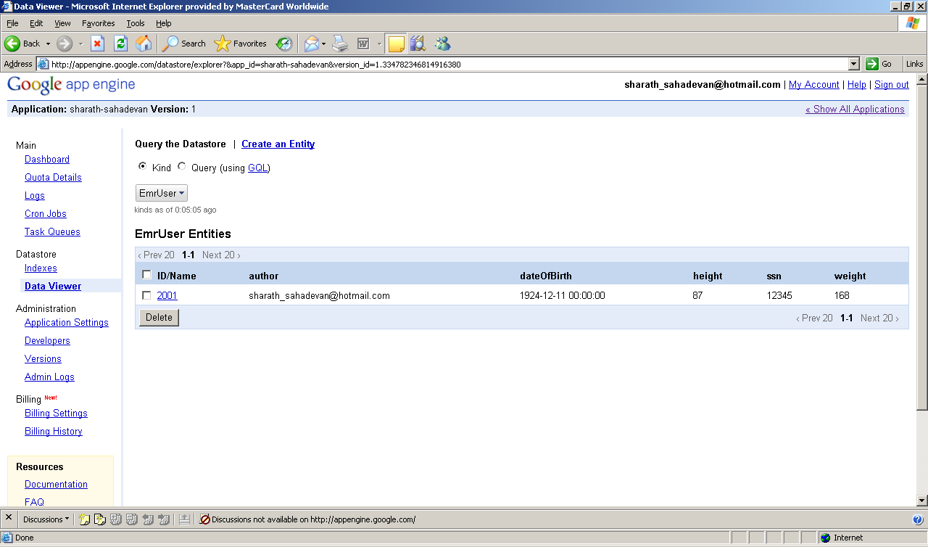
Viewing the data

Slide 27
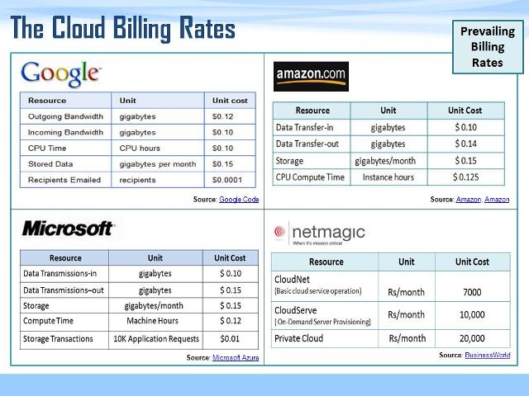
Comparing the services

Slide 28
Issues
Data Privacy
Not Open

Slide 29
Where is it used?
The New York Times needed to convert 11 million articles and images in its archive (from 1851 to 1980) to PDF. Their Internal IT said it would take them seven weeks. In the meantime, one developer using 100 Amazon EC2 simple Web service interface instances running Hadoop (an open-source implementation similar toMapReduce) completed the job in 24 hours for less than $300. —open.blogs.nytimes.com, “Self-service, Prorated Super Computing Fun!”11/1/07, open.blogs.nytimes.com/2007/11/01/self-service-prorated-super-computing-fun/

Slide 30
Demos
Demo of Amazon SQS Client
Application on Google App Engine – Use Google account( gmail id) to login to app.

Slide 31
Questions ?
???

Slide 32
Acronyms
Iaas – Infrastructure as a service
Paas – Platform as a service
Saas – Software as a service

Slide 33
Useful links
http://ss-demo-emr.appspot.com/emr/Main.jsp - Link to application on Google app engine
Java Library for simple DB
http://developer.amazonwebservices.com/connect/entry.jspa?externalID=1132
http://www.pcmag.com/article2/0,2817,2340325,00.asp

Slide 34
References
http://developer.amazonwebservices.com/connect/entry.jspa?externalID=848&categoryID=152
Cloud Computing Primer – Sun Microsystems
http://kenai.com/projects/suncloudapis - Sun Cloud API

Slide 35
References (Cont)
http://www.infosysblogs.com/cloudcomputing/2009/07/is_price_the_only_criteria_to_2.html?soc=rssblg
http://en.wikipedia.org/wiki/Cloud_computing#Architecture
http://www.salesforce.com/cloudcomputing/

Slide 36
References (Cont)
Bridging The Clouds
- Forbes
Microsoft Azure
http://upload.wikimedia.org/wikipedia/commons/c/cd/Cloud_computing_economics.svg
http://developer.amazonwebservices.com/connect/entry.jspa?externalID=1633&categoryID=102

